Slide 1


HCBS Tenant & Customer Participation
Take part, have a voice and make a difference

Slide 2
Agenda
Welcome and Introduction
Introduction to Tenant Participation
Focus of TP
New Meeting Format – Quarterly
Interested Tenants
Other ways to get involved
What TP means to Tenants

Slide 3
Welcome and Introductions

Slide 4
Introduction to Tenant Participation

Slide 5

What is Tenant Participation?
The right to be listened to and involved
Notes:
Landlords have a legal obligation to involve tenants and service users in decisions.
The Housing (Scotland) Act 2001 gave tenants the right to be asked for their view and to take part in decisions.
It also made this a duty for all councils and housing associations in Scotland.
Tenant Participation (TP) means tenants can have a say on things like:
Rent levels
Repairs
Service delivery
Housing issues that affect you

Slide 6

Focus of TP
Voice
Skills/Confidence
Location
In Partnership
Notes:
Voice – Tenants having their voices heard
Skills/Confidence – Build confidence and gain skills
Location – In person meetings at the Civic Centre
In Partnership – Work in partnership with the council

Slide 7


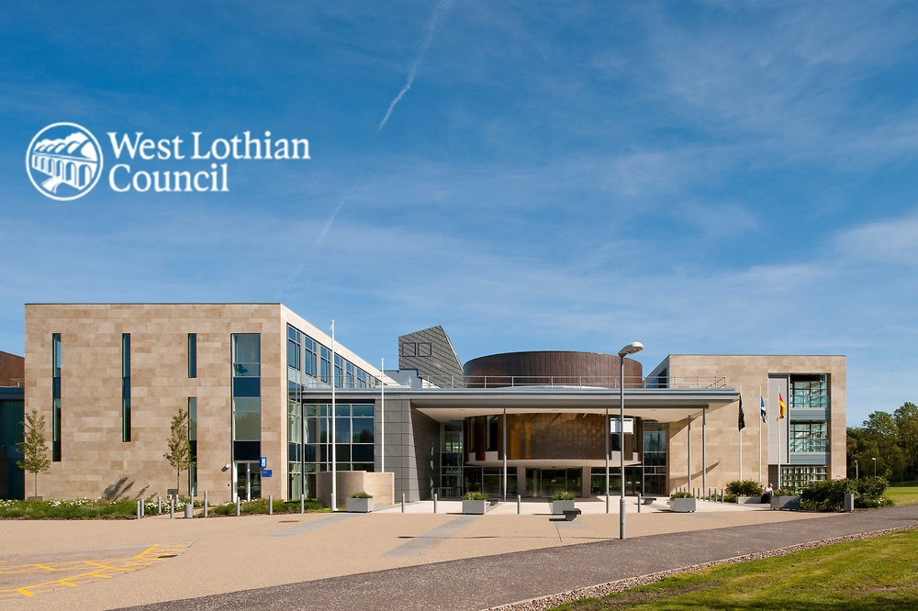
Our “new” TP
Notes:
All meetings will take place in person at the Civic Centre in Livingston
Format:
30 mins – Performance Update
30 mins – Service Updates
45 mins – Topic of Tenants choice
15 mins – AOB / Tenant Questions
Meetings will take place once a quarter and like todays meeting, you will get to vote on which date and time suits you best to attend.
After the meeting all the information shared will be put onto our website and the link will be shared with our interested tenants.

Slide 8
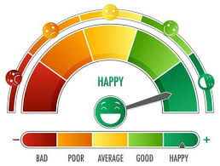
Performance Report
Set goals
Measure results
Report the results
React to the results
Notes:
Performance reporting a means by which to check and monitor how well something is doing and a way by which to show the results.
It is about the service setting goals, measuring the results and sharing them in an understandable format. Our performance reporting is also a way by which we can show people what we are doing, or plan to do to make improvements.
When I go through performance with you at the meetings, you will be provided with a range of performance indicators (PIs/ KPIs), and I will take you through them and explain what the services are doing to improve and or maintain performance.
You will also have the opportunity to give me your feedback and if you want to see other parts of the service performance, we can do that too.

Slide 9
Interested tenants
An “Interested Tenant” is a tenant who wants to be involved in their landlord’s decisions and activities.
Ultimately, it means:
A tenant who wants to have their say
Someone who wants to be consulted and/or informed
A tenant who may take part in things like surveys, meetings, surveys or other events.
Notes:
An interested tenant is a West Lothian Council tenant who has told us they would like to be consulted and involved in TP.
Ultimately, it means:
A tenant who wants to have their say
Someone who wants to be consulted and/or informed
A tenant who may take part in things like surveys, meetings, surveys or other events.
We will contact interested tenants from time to time to allow them to attend and participate in different events related to their area of interest.
As an interested tenant, you can use your experience and knowledge to improve the service you receive in a way that suits you.
If you would like to become an interested tenant, please contact our Quality Development Officer by emailing TP@westlothian.go.uk or by calling 01506 280000.

Slide 10

Other ways to get involved
Facebook
Customer Experience (CX) surveys
Events
Notes:
Facebook: There is a dedicated Tenant Participation Facebook Group for council tenants. This is available to West Lothian Council tenants only. If you are on Facebook and want to join, we can help you do that today.
Customer Experience (CX) Surveys: Our CX Officers might call you to complete a survey. This is to get your feedback on the service and any valuable insights.
For example we have:
New Tenant Visit Surveys
Housing Office Feedback
New Build Surveys
Events- we have been carrying out more in-person, collaborative events such as pop-up shops and estate walkabout and such like. We are also attending an increasing number of functions and would love you to be involved.

Slide 11
What TP means to our Tenants
We asked our participating tenants what TP means to them:
Having a voice
Satisfying
Social
Meaningful
Giving Purpose
Engaging
Challenging
Action for Tenants

Slide 12
Questions / Answers

