Slide 1
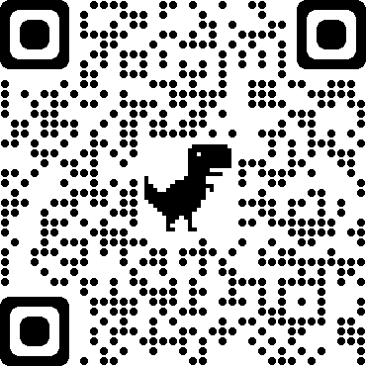
Four Pillars of Wellbeing
Supporting our employees through their wellbeing journey…
Information available on Mytoolkit/Employee Health & Wellbeing/Four Pillars of Wellbeing

Slide 2
Healthy Working Lives – Summer Week 13- 17 June 2022
Competitive Events
Steps in Work Challenge
Jog Scotland
Active Selfie
In-Person Events
Work Place Chaplaincy
Financial Drop in Clinic
Andy Man’s Club
Virtual Events
Deskercise with Physio
Cost of Living Workshop
Access to Work Session
Other Activities
Cancer Information & Support Services
Exercise Webinars
Martin Lewis Podcasts
Men’s Health and Wellbeing videos
Further information on any of these events visit the Council’s Four Pillars of Wellbeing webpage or discuss with your line manager

