Slide 1
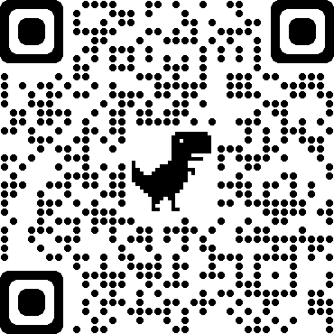
Four Pillars of Wellbeing
Supporting our employees through their wellbeing journey…
Information available on Mytoolkit/Employee Health & Wellbeing/Four Pillars of Wellbeing

Slide 2
Healthy Working Lives – Virtual Autumn Week
Talk Money : 8-12 November 2021
Steps in Work Challenge
Exclusive discounted Xcite membership
Physio-led desk based exercises
Carers of West Lothian Coffee Morning
Free Xcite online, on demand exercise classes
Healthy Eating on a Budget
Macmillian @West Lothian Cancer Information & Support Services
Jog Scotland mixed abilities classes
Poverty Awareness
Further information on any of these events visit: Mytoolkit/Employee Health and Wellbeing/Wellbeing Events or discuss further with your line manager
This Photo by Unknown Author is licensed under CC BY-ND

