Slide 1





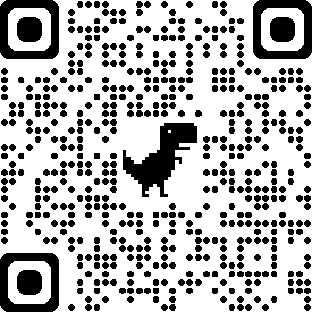
Four Pillars of Wellbeing
Mental
Employee Assistance Programme
Men's Mental Health
LGBTQ+ Mental Health
Self Help Supports
Physical
Get Active Advice
Healthy Eating Options
Addiction Supports
Lifestyle challenges
Financial
Income Maximisation Checks
Money/Debt advice
Housing and Energy Advice
Budgetary Support
Workplace
Health and Safety Information
First Aid at Work
Risk Management
Safety Alerts
Supporting our employees through their wellbeing journey…
Information available on Mytoolkit/Employee Health & Wellbeing/Four Pillars of Wellbeing

Slide 2

Healthy Working Lives – Virtual Summer Week :
10-14 May 2021
Live Events
Steps Challenge
Active Selfie
Money Matters Desk Exercise
Stress-less
Mentally Healthy Workplace
Food for Thought
Information
Four pillars of wellbeing
Parks Gardens & Woodlands
Exercise webinars
Intro to Pilates
Mental Health Awareness
Groups
Men & Women Matter
Macmillian @ West Lothian
Carers Coffee Mornings
Livingston Health Walk
West Lothian 50+
Further information available on:
Mytoolkit/Employee Health and Wellbeing/Wellbeing Events or line manager
This Photo by Unknown Author is licensed under CC BY-ND

