Slide 1

Sport in West Lothian: Knowing Your Funder
Session 2 - Understanding outcomes and the power of storytelling

Slide 2






Zoom
Speaker view
Chat
Reactions
Mute / unmute
Move
Look around

Slide 3
Agenda
18.35 Introduction
18.40 Setting The Scene
18.45 Colin McMillan, Firstport
19.05 Question & Answer
19.15 Application Review (breakouts & discussions )
19.40 Group Feedback
19.50 Summary
19.55 Closing Remarks

Slide 4
Setting the Scene
MOVING FOCUS TO OUTCOMES IMPACTS!
Outputs
Things that Happen
Outcomes
Impact Created

Slide 5

What a funder looks for
Colin McMillan
Programme Manager (LaunchMe)

Slide 6
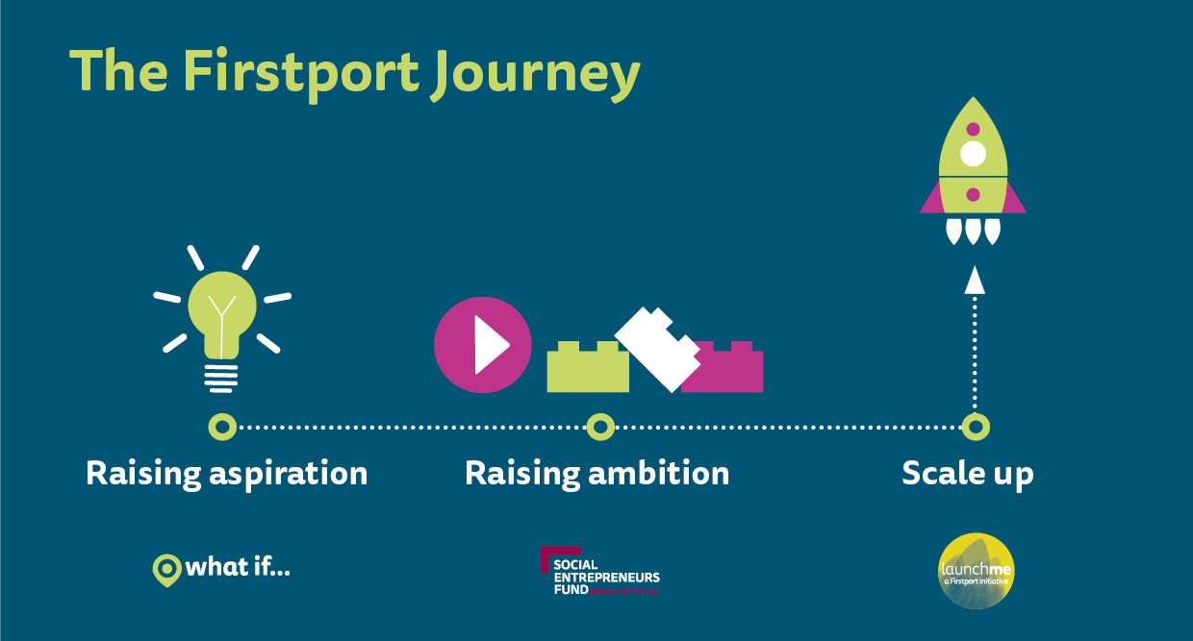

Slide 7
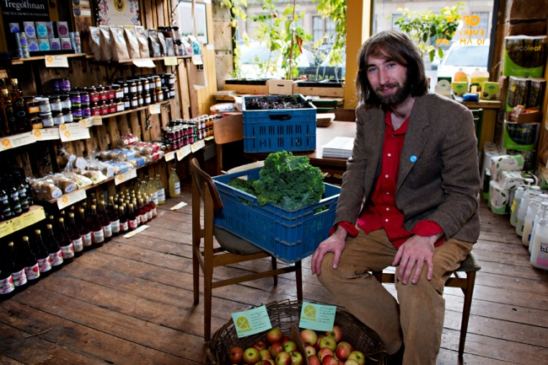
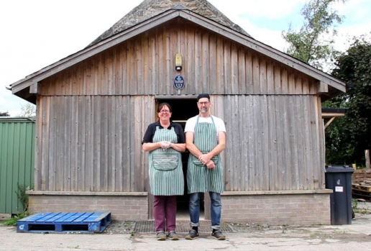
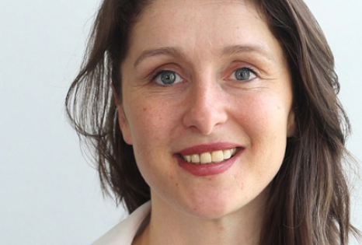
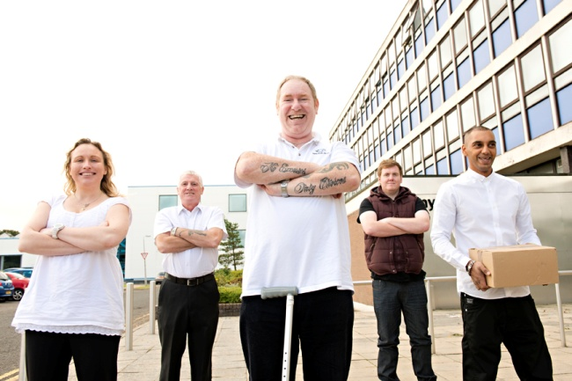
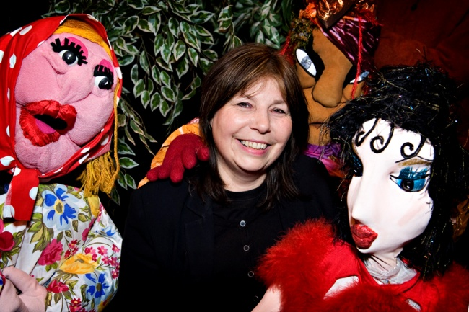

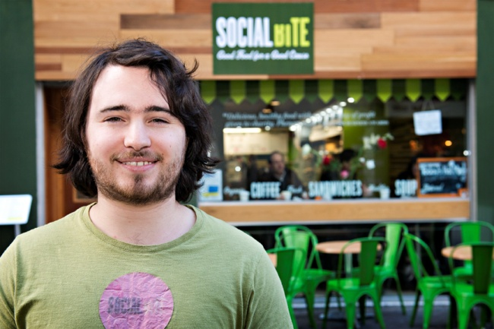
Social Entrepreneurs in Scotland
Notes:
Some of the entrepreneurs we work with in Scotland on a day to day basis

Slide 8


What do funders look for?
A close matching with their priorities!
Eligibility (criteria and costs)
The feeling of adding value
A relationship / building trust (engagement and understanding)
Outcomes based results (financial and/or social - depending on institution) – understanding outputs vs outcomes

Slide 9


Slide 10


Slide 11
What do we look for?
Start It
Entrepreneur
Social Purpose
Commercial potential

Slide 12
Social Beneficiary - Journey
Mental Health
Physical Health
Employment
Education & Attainment
Poverty
Hunger
Equality
M&E
Indirect Impact
M&E
M&E
M&E
Direct Impact
Social Beneficiary
Direct Impact
20 years time – that person will be in a less favourable place without intervention
Intervention 1 (Internal source)
Intervention 2 (Internal source)
Intervention 3 (External source)

Slide 13
What do we look for?
Build It
Business Plan
Financial Forecast
Application form
Entrepreneur
(and people around them)
Social
(track record & potential)
Commercial
(track record & potential)

Slide 14
Boost It

Slide 15


Slide 16
Recovery Programme
‘Adapt and Thrive’

Slide 17

A Programme to Help Build Back Better
Part of £25m Third Sector Community and Recovery Programme.
Designed to help organisations in the third sector to adapt to the challenges presented by Covid and kick-start their recovery plans:
Specialist advice around re-opening or making changes to operate sustainably
Grants of between £5 and £25k
Zero interest loans

Slide 18
Programme Eligibility Criteria
You will be:
A charity, community group, social enterprise, or voluntary organisation
Based in Scotland
Facing significant disruption to operations and delivery
Financially negatively impacted
You will need to:
Have been operational and making an impact prior to COVID
Reflect the needs of the communities you serve
Have a plan to help recovery in your community
Be allowed to open and operate
Be able to engage with support to create and deliver your plan
01
01
02
02
03
03
04
04
05

Slide 19

A Range of Advice and Support
Business model and business plan
Financial position and forecast
Income generation and sustainability
Organisational structure
Statutory regulations
HR & staffing issues
Digital service delivery
Remote and flexible working
Service redesign
Critical friend

Slide 20
Funding
£5-25k
£25-250k
£25k+
Blended (grants and loans)
Minimum loan
0% interest
loans
Grants

Slide 21
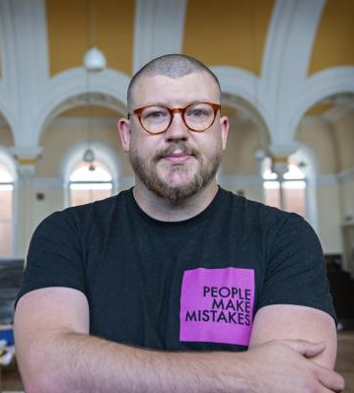
Grant Eligibility Criteria
(In addition to programme eligibility criteria)
Income of < £500K
In a stable financial position prior to Covid
Cannot implement changes in recovery plan without funding

Slide 22
Funding Priorities
01
Organisations operating in areas or with individuals who have suffered disproportionately from the effects of Covid
02
Organisations working with people who have protected characteristics or the most vulnerable.
For example:
those who were recommended to shield
furthest away from the job market
encountering barriers due to physical/mental health
For example:
areas of relative deprivation
individuals experiencing isolation
those who have been pushed into crisis due to the pandemic

Slide 23




Eligible Costs
£
Adapting Premises
Staff Salaries
Short-term staff
Capital Expenditure
Stock or materials

Slide 24
Ineligible Costs
Lost income from previously planned events/ projected loss of revenue
Staff costs associated with service delivery
Any retrospective costs
Any historical debt
Activities and goods related to current delivery or emergency support
Activities that do not align to the Government’s phasing plan

Slide 25



How to Apply (from w/c 21st September 2020)
01
Visit the SCVO website
£
02
Complete the online form
03
Speak with an advisor
04
Apply for funding
Prior to launch, you can register for updates at: https://scvo.scot/support/coronavirus/funding/scottish-government/recovery

Slide 26

Firstport website
@firstport | info@firstport.org.uk
Notes:
Introduce myself and a round table introduction of who everyone is.
Each participant to write on a Post-It note what they think a Social Enterprise Is.
Aims of this short course
Give you an introduction to the concepts of a Social Enterprise
2. Enable you to develop an understanding of different sectors of business, while also being able to differentiate between voluntary organisations and social enterprises.
3. Provide you with an overview of :
Company Limited by Guarantee
Registered Charity with a Trading Arm
Community Interest Company
Firstport, Scotland UnLtd and our common support through Just Enterprise
Hopefully motivate you that you want to consider YOUR Social Enterprise idea further with Just Enterprise support!

Slide 27
Question and Answer Session
1. What are the main advantages to looking for funding by linking in with firstport rather than just going it alone?
Firstport are a funder of social enterprise start-ups. We provide business support to social enterprises while also offering funding to help them establish the social enterprise as a sustainable business. We can help steer people to find funding, but usually this is something that the business will be supported with elsewhere in the ‘support ecosystem’, for example at the Third Sector Interface (TSI) or the Social Enterprise Network (SEN). The advantages of being funded by someone means that there has been an element of due diligence done by the organisation and therefore new funders can be reassured that the organisation is able to manage the funding appropriately.
2. What are the main priorities that you see for funders in the next 3-6 months?
  From our perspective at Firstport, the key thing is being able to support with rebuilding the economy, particularly looking at the Scottish Governments ‘Wellbeing Economy’ strategy. Businesses need to be able to emerge from COVID-19 and we need to help with minimising the impact on jobs. However, more broadly with funders, I think that we’ll see priorities moving to dealing with communities that have been disproportionately affected by COVID-19. This means that the targeted social impact approach will be a focus now more than ever. For sport clubs and organisations who are at the heart of many communities, there are great opportunities to be able to help people through these hard times. However, the target can’t be solely supporting existing club memberships on their own, but focussing on engaging with the ‘real community needs’ and tackling those problems through sport.

Slide 28
Question and Answer Session
3. What key bits of information would show sustainability to a funder (in terms of a project and a club/organisation)?
Firstly, clarity on the vision, mission and long term objectives and that the ‘targeted’ social impact is a very clear part of the club. Good governance is a key part of being able to illustrate sustainability and continuity. Sometimes funders will expect to see that the organisation has moved from an unincorporated association to a charity, such as a SCIO. Being regulated by the charity regulator is another safeguard for many funders that there is sound governance in place. This also links in with the leadership team and the people in the organisation in terms of the turnover of key people. Different funders look for different things, however a business plan and financial forecast that incorporates an explanation of what has been achieved to date and what will be achieved in the future (both with and without funding) would illustrate sustainability to a funder. Also, good connections in the community particularly with regards to organisations/charities working in the community is something that builds confidence in a funder.

Slide 29
Question and Answer Session
4. Do you have any links or advice on other funders who may also fit with our impacts around women and girls?
A great funding resource is the Funding Scotland website which is part of the SCVO website. https://fundingscotland.com/. This has a great search mechanism to look for funding, allowing you to target specific groups, age ranges, beneficiaries, etc. There are many funds targeted at West Lothian women and girls.
5. Is it ever appropriate to go back to a funder(where you have been awarded a grant) if there are unexpected or hidden costs or you are affected by major changes? What advice would you give to a club in this situation?
Always keep an open dialogue with your funder. This relationship will stop you from getting tied up in knots further down the line. Usually funders require evidence of spend through receipts, so it is always best to ask what is appropriate spend and not. If you need to make changes to spend throughout the course of the project, you should contact the funder to discuss your options. It is wise to have a few solutions prepared which the funder would be able to talk through with you. An example of what we have seen with COVID-19, most funders decided to move their funding from ‘restricted’ to ‘un-restricted’ funding which allowed organisations to spend the funds on survival.

Slide 30
Question and Answer Session
6. Do you know of any funders that would support individual athletes and in particular with disposable income?
So funding wise for individual athletes. The one that we steer people towards is Sports Aid Scotland. I think that they are still providing support for young athletes (up to 22 years old). It really depends on the person that the funding would support. Another option which I would strongly advise is going to the local Rotary club, presenting to them on the merits of supporting/sponsoring someone. As an ambassador for their local area, they would benefit the Rotary as well as the local area and indeed the country (which could be a worthy funding for a Rotary club).
However If it is a targeted intervention to someone from an SIMD area etc. there are probably a few funds. Potential avenues:
Neil Mackenzie Trust
Forth Giving
West Lothian Educational Trust – obviously has to have an educational purpose in addition to sport

Slide 31
Break Out Groups
Funding Applications
Review and discuss the Crags application to the Robertson Trust

Slide 32

Group Feedback

Slide 33
Plenary Notes
Clearly see how there had been time taken to understand the needs of the community around them. They looked at the challenges for the community and positioned themselves at the heart.
Clear effort made to engage with the funder and then to align to the priorities of the funder.
The application was brought to life using stories of people being impacted.
There is an opportunity for us to share experiences across West Lothian and supporting each other with feedback from successful application etc.
Balancing out facts and figures with the story telling
Discussion around specific research and using this in the best way
Looking at areas in West Lothian where there are similarities to the area around the Crags which could help shape other applications.
The personal examples really bring the application to life
Quite a jump between smaller funds and the larger funding organisations.
Would be helpful to spend more time working collaboratively in partnership settings.

Slide 34









Funding Map
Community Sport can help you at any part of your investment journey.
Impact
Help to create an impact driven approach.
Know your funder
Know your community
Tell your story
Be a bridge between funders.
Tools and resources to help understand your community.
Tools and resources to create a mixed organisational story.
Investment ready
Continual monitoring
Sustainability
Get you ready to receive investment.
Tools and support to embed monitoring and evaluation in your club.
Tools and planning for sustainable goals.
Achieve your outcome
Help you receive targeted investment where it is most needed for the greatest impact.

Slide 35
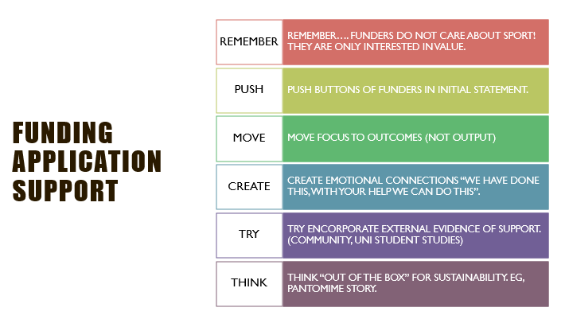
Summary

Slide 36
Closing Remarks

