Slide 1
How to Make a Good Occupational Health Referral
R-CG-034
Version 1
8th October 2019

Slide 2
Requirements
Time allocated – 1 hour to review the document

Slide 3
Objectives
At the end of the presentation managers will understand:
Managing absent employees – OH Referral process
Manager Information and Support Services available
The role of O.H. in attendance management
What to include in the OH referral
The OH Assessment process and OH report structure
Rehabilitation and return to work plans
What constitutes a Disability under the Equality Act 2010
Steps to take to clarify their understanding of a report
Action to take following receipt of the report

Slide 4
Managing Attendance Guidance for Managers 1
A management referral to Occupational Health is appropriate when a manager needs:
Clear, concise advice about the health and fitness of employees to enable the Line Manager to deal fairly with the employee.
Where there is concern around an employee’s fitness for work:
    e.g. work related illnesses; frequent short term absences; performance issues that maybe related to ill health
Where there is concern about the effects of work on an employee’s health, or the
effects of a health problem on an employee’s performance, ability to carry out their
role or their attendance at work.

Slide 5
Managing Attendance Guidance for Managers 2
Cases that do require prompt referral to occupational health are those involving:
Musculoskeletal conditions
Stress and Mental Health cases (e. g depression, anxiety and stress related illness)
Drug and alcohol dependency.
If an absence continues or is likely to continue for more than 7 days, a management referral is recommended.
Please refer to your Attendance Management Policy for more details on when and why to refer.

Slide 6
Health Issues Requiring Referral to Occupational Health 1
Mental Health
Stress, depression, anxiety or other psychological or psychiatric conditions – if possible referral to be made on the day management are made aware of the health issue.
  Work related trauma – Give EAP details and Refer for Fast Track Trauma
  None work related trauma – Give EAP details, signpost to GP and make OHA referral.
  None trauma related psychological issues – Give details of EAP provider and signpost to GP.
Workplace Accidents/Injuries/Disease
Accidents, injuries, or diseases contracted in the workplace - if possible referral to be made on the day management are made aware of the health issue. This would be to the OHA(Occupational Health Advisor).

Slide 7
Health Issues Requiring Referral to Occupational Health 2
Musculoskeletal (MSK)
    Musculoskeletal conditions for example: sprains, strains, fractures, back pain, hip pain, knee pain
    Refer to OHA for this and also consider a direct referral to physio.
Health conditions impacting on the employees ability to undertake their duties.
    eg surgery; arthritis; diabetes; asthma
All continuous sick absence any period exceeding 7 days.
Complex cases where there are multiple factors contributing to the absence
Recurrent short term absence where there is no medical evidence to support the absence. Initially to OHA.

Slide 8
Manager Information & Support
Occupational Health Referral - via OH Portal - www.myohportal.co.uk
Online guides available to help navigate the portal
OH Administration Helpdesk for queries the portal can’t answer
Occupational Health Case Conference – Manager, HR, Occupational Health Advisor
Optima Health Online – website with more information
Optimize – Health and Wellbeing website for all staff

Slide 9
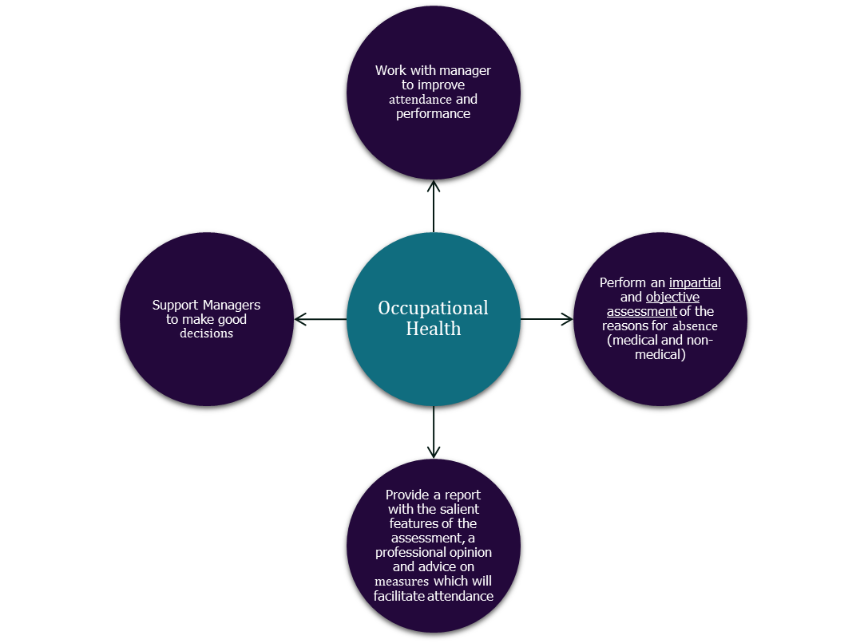
Role of OH in Attendance Management

Slide 10
Role of OH in Attendance Management
Occupational Health Practitioners DO NOT undertake any of the following:
Manage sick absence or performance - this is the role of the manager
Tell managers what to do - we give advice and you decide if you want to implement it.
Predict sick absence or decide how many days should be tolerated – management decision.
Disclose medical information that isn’t relevant - we can only disclose what is agreed by the employee as this is their information. It is more useful for us to advise on their capability.
Diagnose and treat medical conditions - this is the remit of the NHS via the GP
Act without informed consent of the patient - if consent is withdrawn to engage with OH services then we cannot proceed. Managers will need to act on the information they have available to them.

Slide 11
Discussing the Absence and OH Referral with the Employee
Nature of the Absence:
  Mental Health – Are they receiving any EAP services? If not provide details so they can self refer to EAP, Has an OH referral been made?
  Musculoskeletal – Are they receiving treatment via their GP? Would a referral for short term physiotherapy through Optima be useful?
Length of expected absence
  does the employee think they will return to work within the week?
  have they sought medical advice from their GP?
  is the absence caused by injury or illness as a result of work?
  can the employer provide any assistance with aiding a return to work?
  does the absence indicate an early referral to OH?
  is there anything concerning the employee? – Is there an underlying grievance, issue with colleague/manager?

Slide 12
Important Information to include on the OH Referral
Medical condition impacting on attendance/performance, if known.
What action has the manager has already undertaken?
Ongoing issues at work that could be an obstacle to return. e.g. disciplinary , grievance
Success or otherwise of any rehabilitation or adjustments already made?
What aspects of the employees work are most affected?
It is important to give as much context as possible in your referral so the practitioner can see the bigger picture.
Identify any specific questions that will aid your decision-making/ help you to manage your employee.

Slide 13
Example Specific Questions –you may ask 3 in total
Questions should be specific and relevant to what you need to know to manage your employee effectively:
Will Mr X be able to undertake specific activity (e.g. walking on uneven ground for x miles) on his return to work?
Will Mr. X be able to work shift patterns on return?
Will Mr X ever be able to resume shift patterns?
Is there any medical reason why Mr X should not resume night work?
Is Mr X medically well enough to attend a disciplinary hearing?
Is Mr X fit to drive a 7.5 tonne vehicle?
Mr X has to do ABC in his role – would he be able to do this on his return to work?

Slide 14
The OH Assessment
Preparing the employee for the consultation – important points for you to discuss with your employee at the time of making the referral:
The consultation may be via telephone or face to face.
If the call is taken at work, then the employee should be waiting in a private room and be contactable on the number that you provided when making the referral.
They should be in the room slightly earlier than the appointment time to ensure a prompt start.
Clients should expect the appointment to last for approximately 20 minutes, but this may be shorter or longer depending on the type of referral made.
The assessment will have a clear structure, it is important that time is utilised effectively, whilst promoting good practice.

Slide 15
Expectations at the OH Assessment
ID Check and Consent
  OHA has to check ID and gain consent from the employee to undertake the referral and to ensure the employee understands the reason for the referral and specific questions being asked in the referral
  Management need to be aware that consent can be withdrawn at ANY TIME during the consultation.
Previous employment history.
Past Medical History
Lifestyle/hobbies/family social aspects
Summarise current health problem
Clarify recent events, treatments, tests, referrals
Assess how ill health affects daily activities
Assess the client - pain levels, mobility, mood
Agree case progression with client and return to work time scales, if appropriate
Discuss and agree rehabilitation programme – subject to managers agreement
Maintain clients electronic OH records
Agree report with the client and review dates, if necessary

Slide 16
How do OH Assess Function on the Telephone? (1)
Mental Health (MH) Function:
OH follow a validated scoring system (PHQ9 and GAD)
MH Assessment:
Self harm intent, past self harm, plans,
Motivation
Memory/concentration/ability to retain information
Sleeping and appetite patterns
Is the employee tearful on the phone?
Physical symptoms: e.g. churning stomach, heart beating fast, pacing whilst on the phone to OH
Lifestyle: if smoker has that increased? Alcohol intake?
If have a young family, managing to care for them or needing help?

Slide 17
How do OH Assess Function on the Telephone (2)
Physical Function/Mobility
Walking: how far? Can they shop? Any walking aids?
Standing: can stand in a shopping queue
Sitting: how long for? Getting up to standing position?
Bending: can get in and out of a car? Empty dishwasher/washing machine
Reaching and stretching: hanging out washing, reaching up to a kitchen cupboard
Stairs: at home? If mobility problems severe, living downstairs?
Hands: grip: open can or open a bottle of water
Driving? Can fill the car up with petrol and grip the petrol pump?

Slide 18
Occupational Health Report Structure
Paragraph 1 - Description of relevant medical issues
  This will include an overview of the current situation, any pending tests/investigations and treatment but will not go into a lot of medical detail as this is not required in an OH report.
Paragraph 2 - Current capacity for employment
  This will advise if your employee is fit for work an in what capacity – it will advise if you need to consider any adjustments, restrictions, phased return to work plans or restriction of duties. This will also advise of a timescale where possible.
Paragraph 3 – Outlook
  This will give an opinion of the likely outlook in terms of recovery with a timescale where possible and any likelihood of recurrence.
Paragraph 4 – Disability Opinion
  This will give you the practitioners'’ opinion on whether your employee is likely to be covered by the Equality Act in terms of disability.
Paragraph 5 – Specific Questions
This will try and give answers to specific questions that you may have asked.

Slide 19
Rehabilitation & Return to Work Plans
Aim
Return employee back into the workplace as soon as possible without harm to themselves/others
To enable and/or support an employee to return to their usual working pattern, whilst incorporating any aspects of job redesign, adaptation or adjustment
Bio psychosocial factors
Build up physical strength and condition
Build up confidence in mental and physical abilities
Challenge psychosocial barriers
Gradual introduction back into workforce
Benefits
Earlier return back to full duties and Compliance with Health and Safety legislation
Positive employee relations. Convey message that employee is valued
Promote image of a caring and responsible employer
Support to Management

Slide 20
Return to work plans and advice
Phased return to work examples:
Usually advised over a period of 2 - 4 weeks if the employee has had a long absence or is still recovering
Generally OH expectation is daily attendance but on reduced hours to help return to work fitness and stamina building
Return to work plans can be extended by managers if they feel this will help without having to check back with OH
Advice given is for guidance only and for management to consider whether the adjustments suggested are viable to support.
Other considerations:
Mentoring and supervision on return
Workstation assessment
Buddy system to help with confidence
Initial return on reduced or restricted duties and a planned gradual increase of duties over the return to work period is likely to help with recovery and rehabilitation if the person is still recovering.

Slide 21
Examples of Adjustments that may be advised for you to consider
Changes to premises, such as installing a ramp, improving signs, or moving someone’s desk nearer essential office equipment.
Provision of additional equipment, such as specific computer software or hardware if this is relevant to their job.
Additional support (for example, a part-time reader for someone who has a visual impairment to help manage the volume of written information which they have to get through).
Reassigning some elements of their job to another member of staff or transferring them to another role in your organisation.
Being accompanied at work for a temporary period.
Suggested adjustments are advisory – it is for you to decide as a business if you can accommodate them.

Slide 22

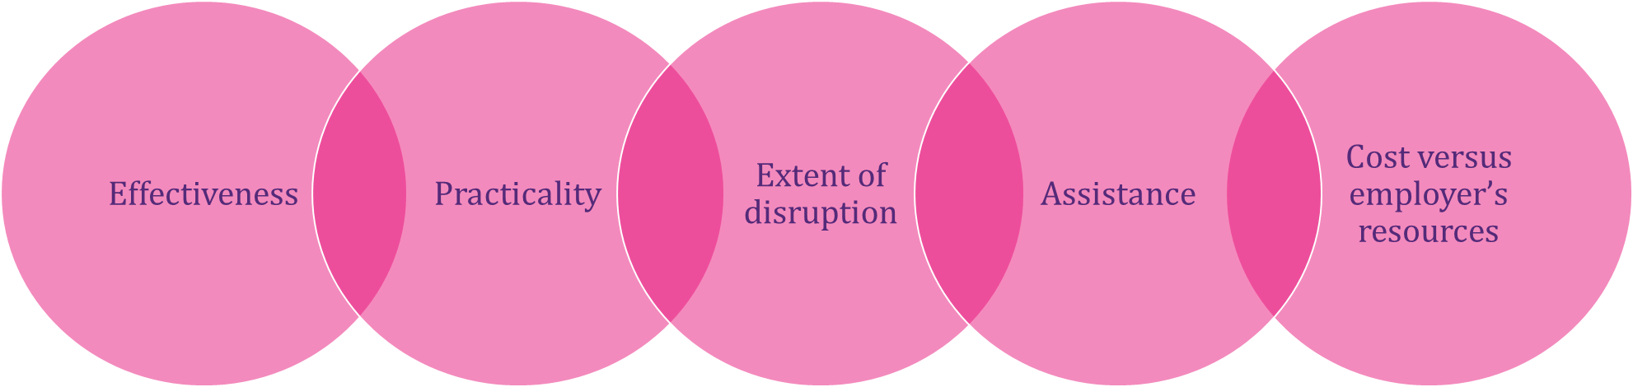
When is an Adjustment considered to be Reasonable?

Slide 23
Further Advice – Disability and the Equality Act
The following factors are considered when forming an opinion on disability and the Equality Act:
Is there a Physical and/or mental impairment?
Is this Long term i.e. has lasted or is likely to last for 12 months or more?
Does the impairment have a substantial effect upon normal day to day activities discounting any treatment effects?

Slide 24
OH Advice on Disability
It is the OH Practitioner’s role to advise the employer of the following:
Whether there is likely/unlikely to be an impairment
If they are not impaired would they be so if they were not on treatment
Whether the impairment has a significant impact on their ability to undertake normal day-to-day activities
The likelihood and severity of a recurrence
What adjustments are appropriate to alleviate the adverse effects of the impairment.
With this information, the employer is then able to make a decision as to whether the condition constitutes a disability under the Equality Act.
The practitioner will also give their opinion of whether the case is likely or unlikely to be covered by the relevant legislation.

Slide 25
Next Actions for Managers
Read the report carefully and make sure you fully understand the advice
Use the feedback button on the portal – Are you satisfied with the report?
  If you are unsure on any point, select NO at the feedback stage on the portal and this will allow you to make comments about why you are not happy with the report. The author of the report will then call you to discuss.
Consult with HRBP or Senior Manager if planning to take any disciplinary action
Discuss the report with the employee and agree outcomes
Agree and implement action plan
Refer back to OH for the same reason/period of absence - only if you have addressed and actioned recommendations in the report.

Slide 26
Remember….
A good quality Occupational Health Referral helps us to provide you with a good quality Occupational Health Report.

